Slide 1
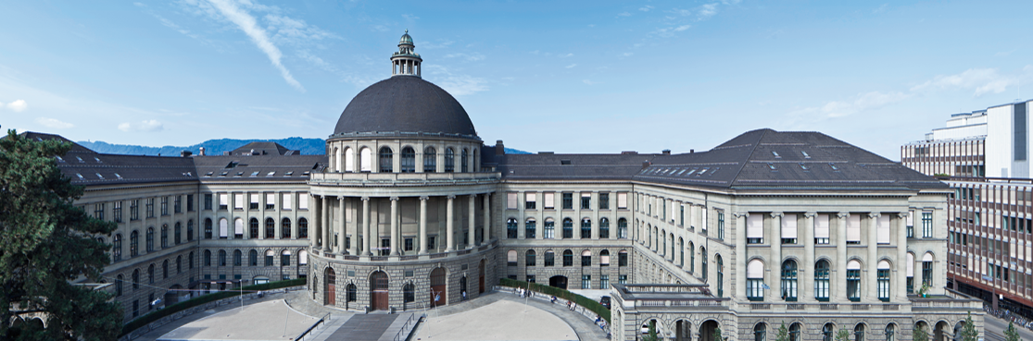
Joint 3D Scene Reconstruction and Class Segmentation
3D Vision – CVG – ETH Zurich
Instructors: Prof. Marc Pollefeys, Dr. Torsten Sattler
Teaching Assistant: Yagiz Aksoy, Johnasses Schönberger, Thomas Schöps, Peidung Liu
Supervisors: Martin Oswald, Pablo Speciale
Students: Adrian Schneuwly, Johannes Oswald, Tobias Grundmann

Slide 2
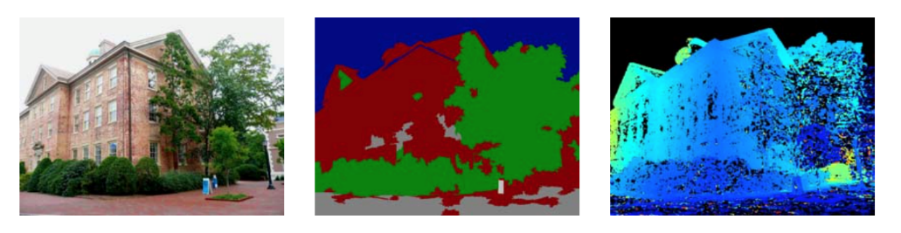
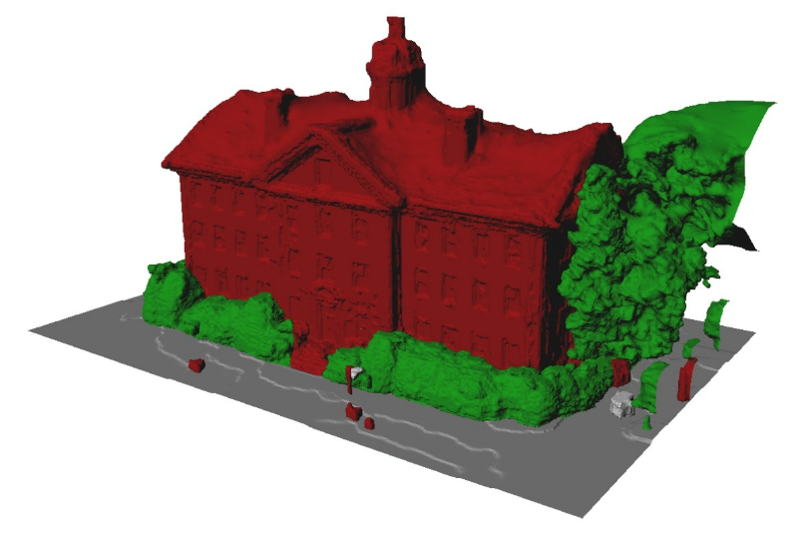
Problem & Motivation
Both ill-posed problems:
Image segmentation
Dense 3D modeling
Solution: regularizers, but it often fails
Papers approach:
Joint segmentation and dense reconstruction
Why does this makes sense?
Image segmentations -> clues about surface orientation
Dense 3D reconstruction -> yields a suitable regularization for segmentation
input image
classification
depth map
Source: Hane_Joint_3D_Scene_2013_CVPR_paper
Result: Accurately labeled 3D reconstruction

Slide 3
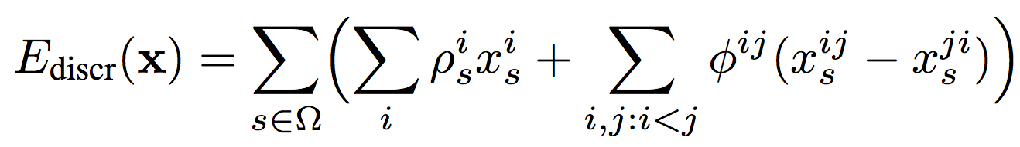
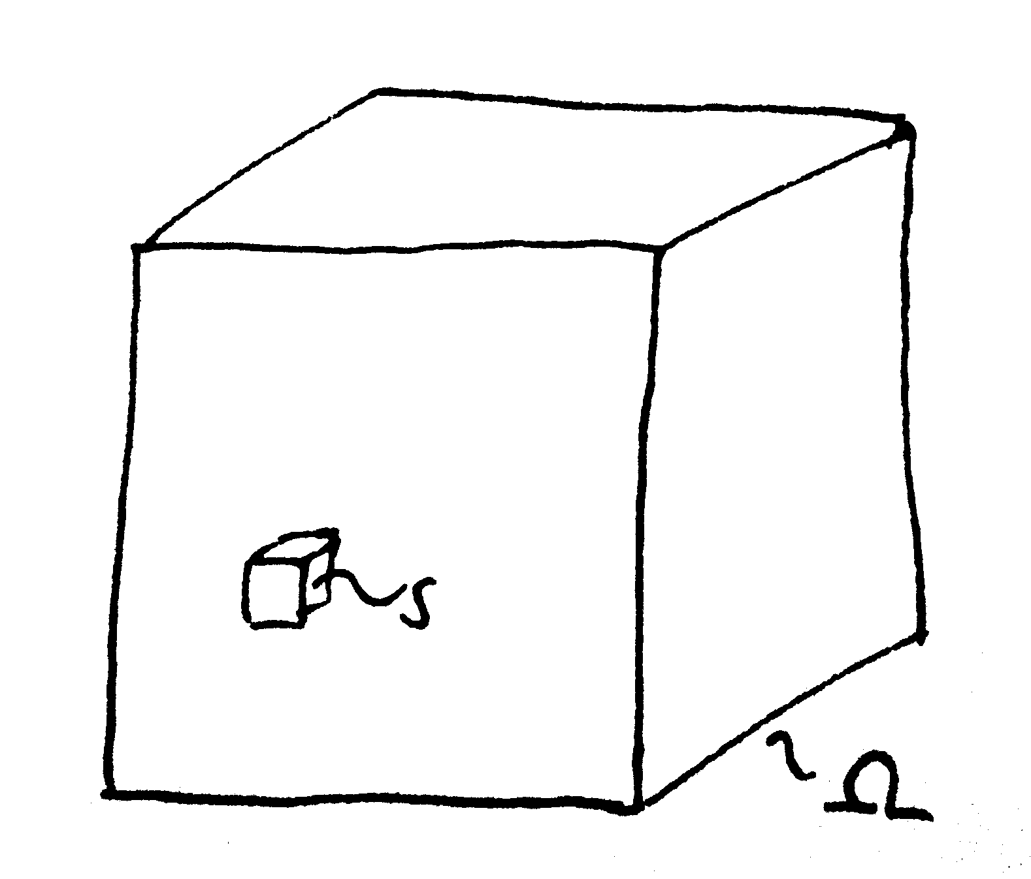
Problem Formulation
Volume containing the whole scene
discrete voxels s
Goal
reconstruct surface
Underlying energy function
minimize

Slide 4
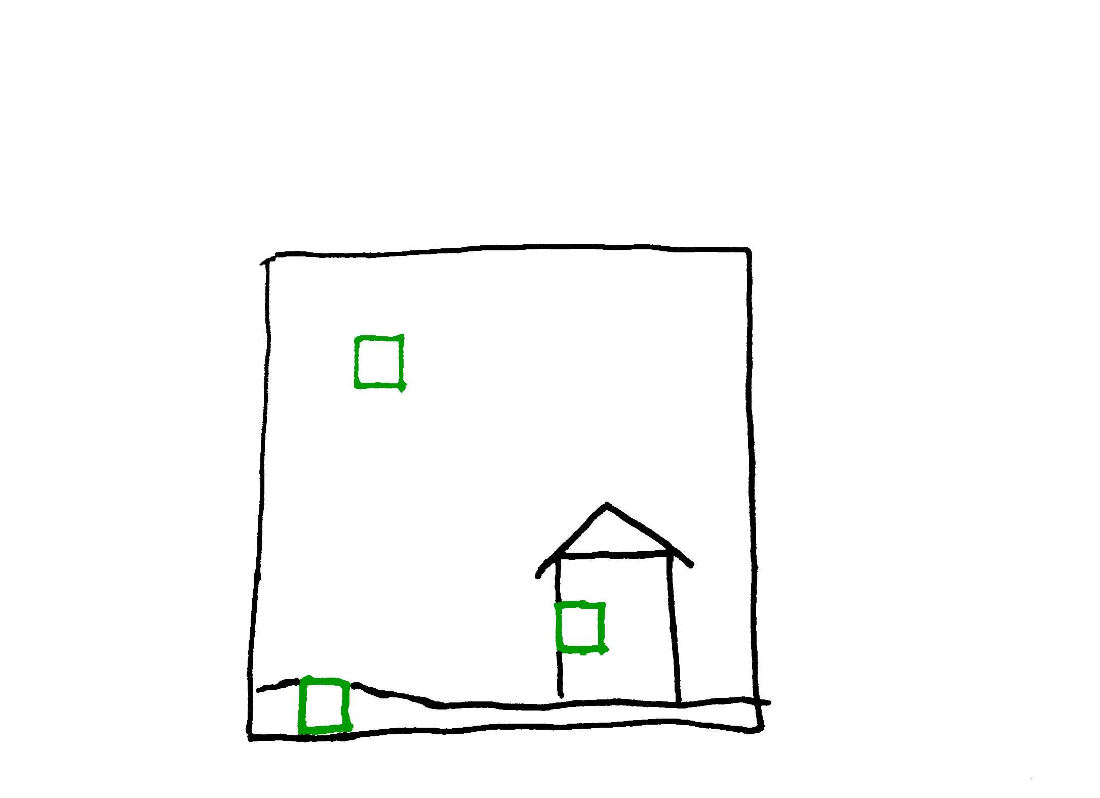

Labels
Tradionally two categories
free or occupied space
Paper devides into more categories
sky (free space), ground, building, vegetation and clutter
Surface
boundaries between regions

Slide 5
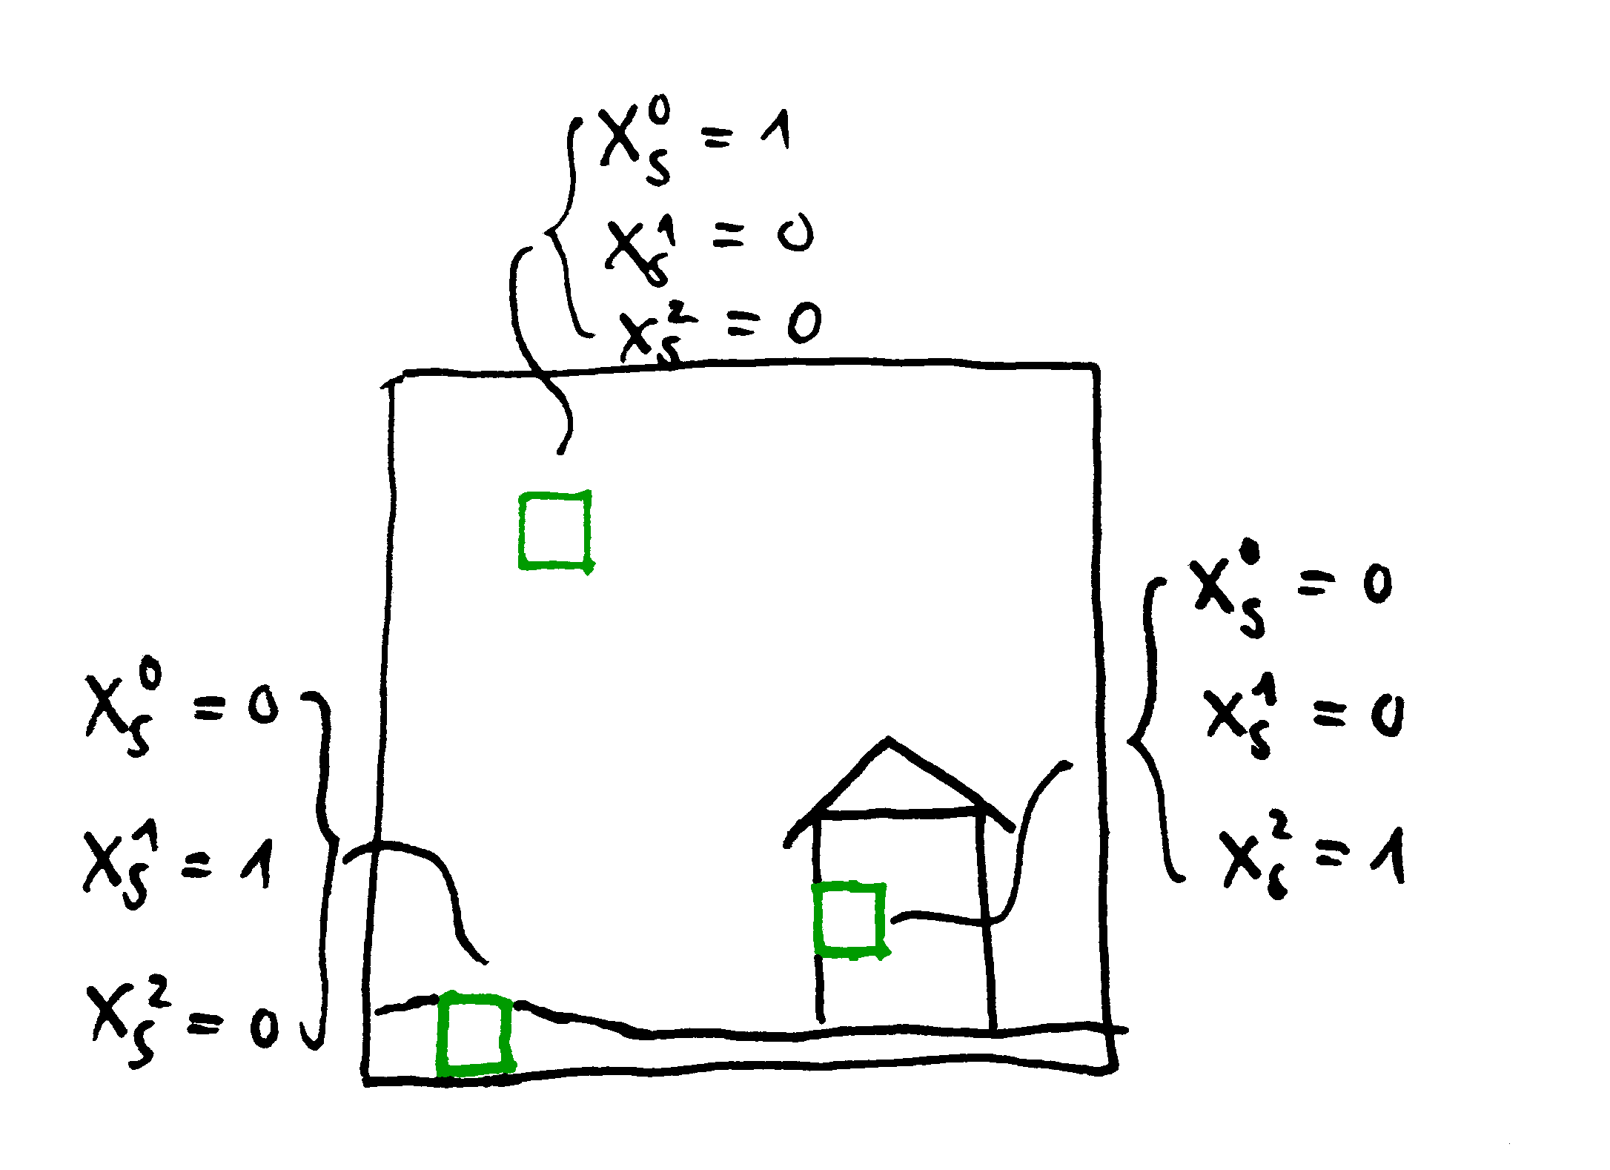
Labels
Tradionally two categories
free or occupied space
Paper devides into more categories
sky (free space), ground, building, vegetation and clutter
Surface
boundaries between regions

Slide 6
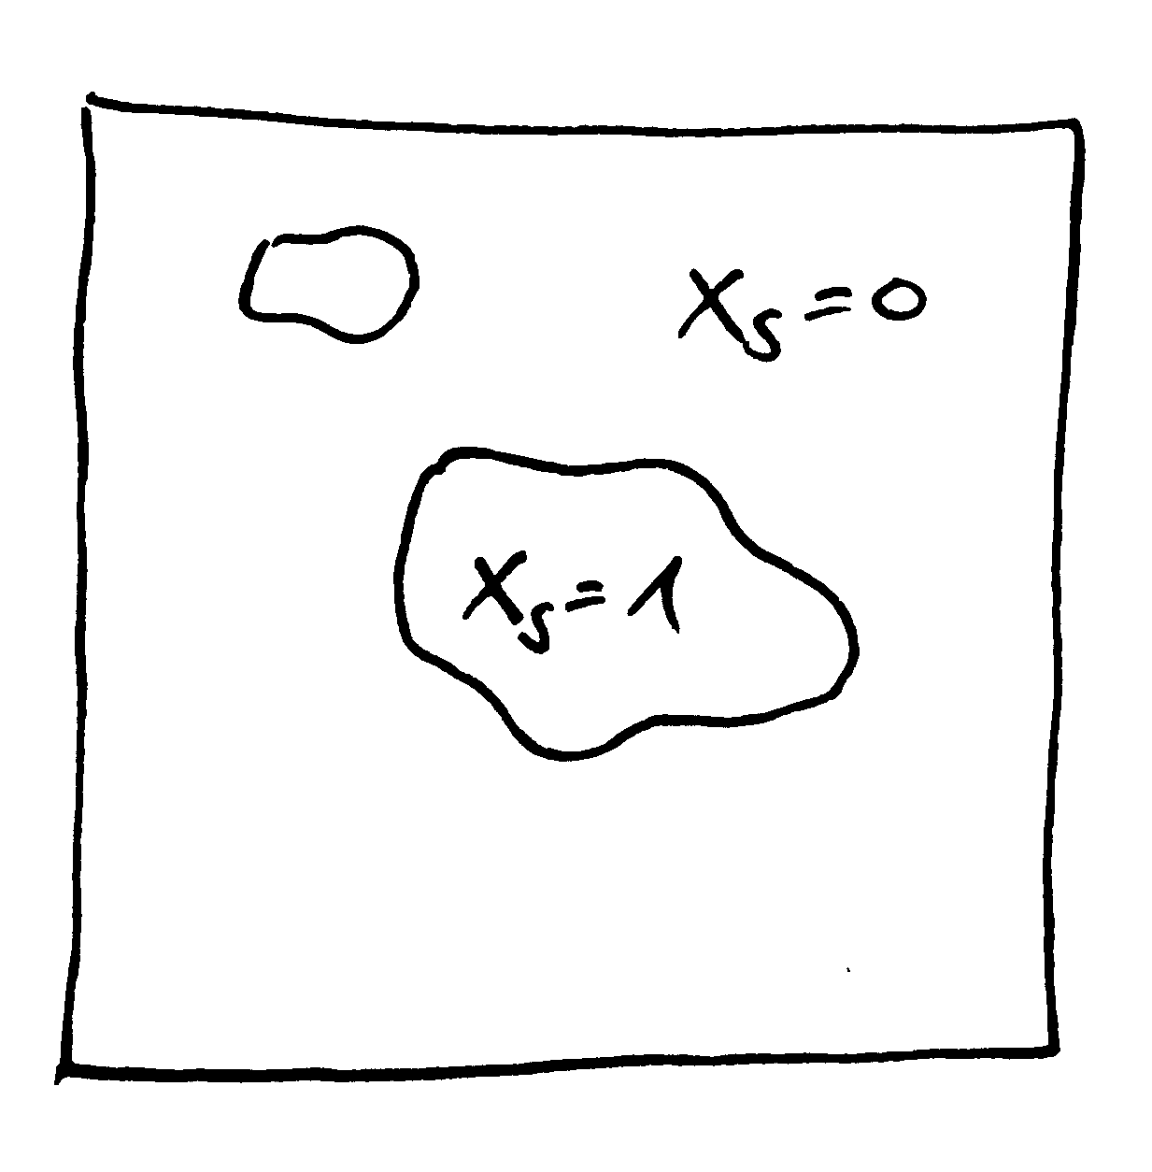
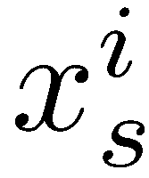
Data Term
encodes whether label i is assigned at voxel s
Example:
simple binary case in 2D

Slide 7
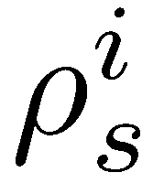
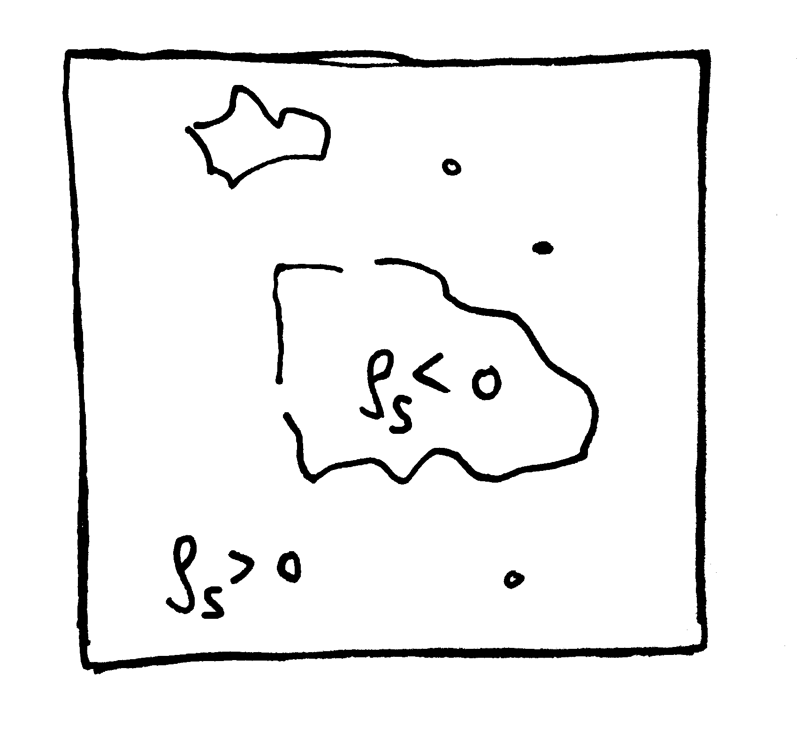
Data Term (2)
missing parts
encodes the local preference of voxel s for a particular label i
Negative means a preference for occupied space

Slide 8
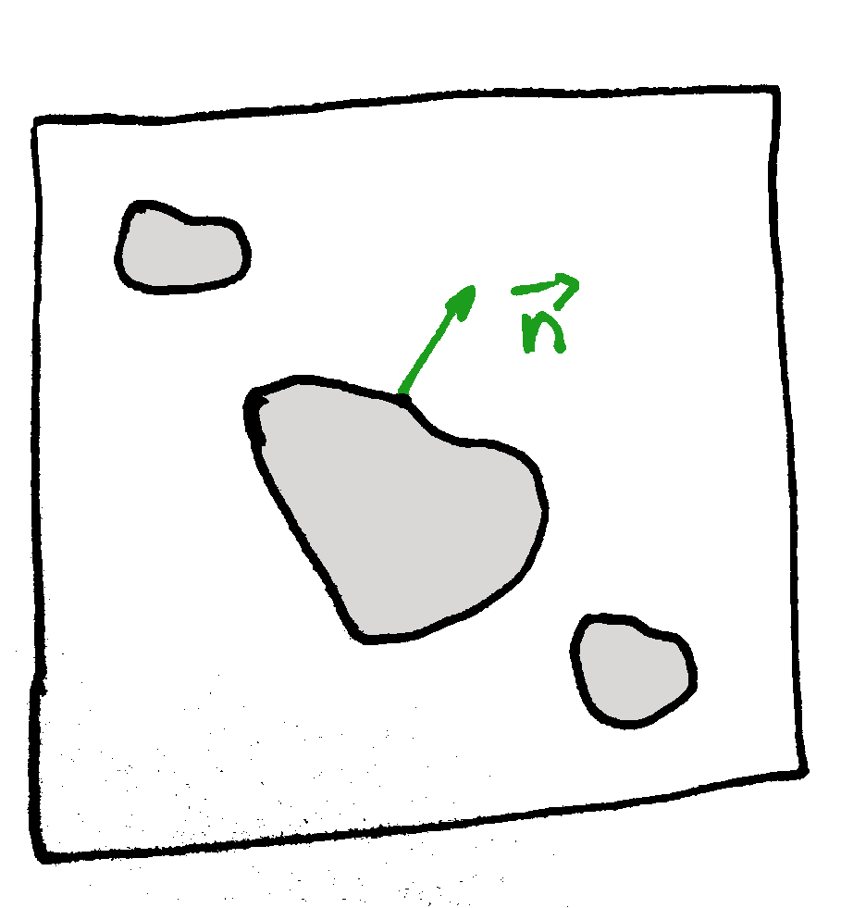
Smoothness Term
weight
local surface orientation
Required to tackle the noise in observed data
Increase surface smoothness
minimizes surface
contributes
no change → zero

Slide 9
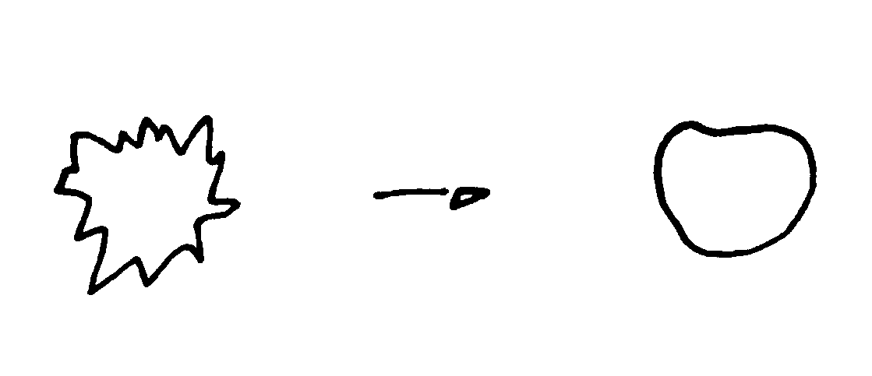
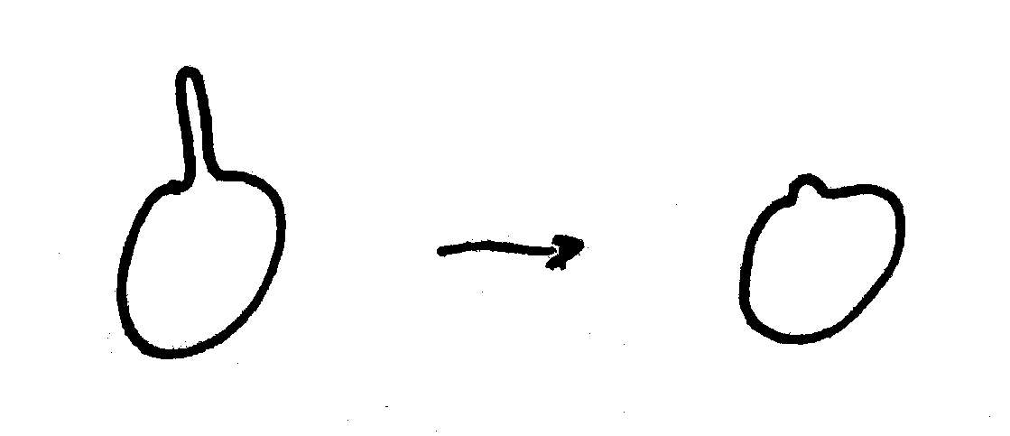
Smoothness Term (2)
Examples
Weight
make certain surface normal more/less costly

Slide 10
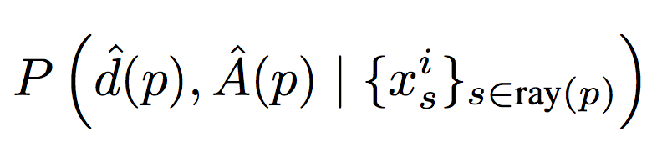
Ray Likelihood and Its Approximation
Goal: Depth maps + appearance-based likelihoods -> unaries ρ
Unaries ρ are calculated along ray from pixel p
Our task: Model the likelihoods
Indicator function for label i and voxel s
Observed depth
Local image appearance in neighborhoods
Two Cases:
1.) Observed Depth
2.) Missing Depth
Notes:
WAS IST sigma sky, nicht klar an der Stelle.

Slide 11
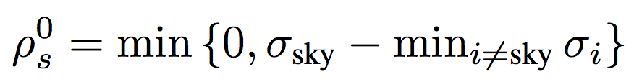
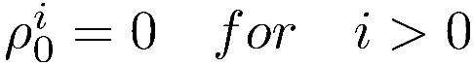
Ray Likelihood – Missing Depth
Mostly occurs in the sky regions.
We set for all voxels along ray(p)
-> Free Space is prefered to avoid bleeding of structure
Notes:
WAS IST sigma sky, nicht klar an der Stelle.

Slide 12
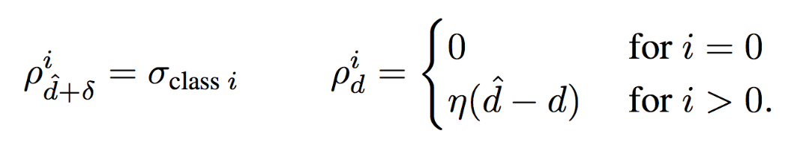
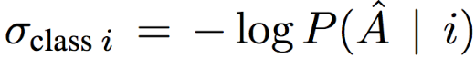
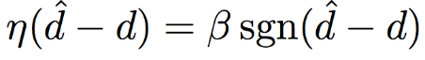
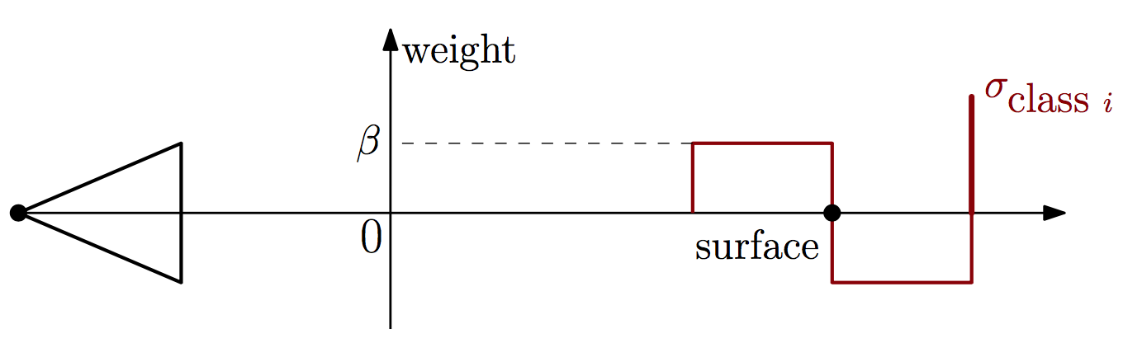
Ray Likelihood – Observed Depth
1.) Assume that likelihoods factorizes into
Confidence of trained appearance- based classifier for object category i
Noise of depth sensing process
2.) Assume inlier noise is bounded δ, then
Source: Hane_Joint_3D_Scene_2013_CVPR_paper

Slide 13
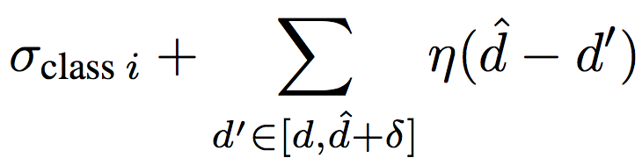
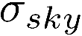
Ray Likelihood – 3 Cases of Contribution
Free-space transition to particular object class i at depth d:
Summing yields
2. All voxels in the range are freespace:
Contribution is
3. All voxels in the range are assigned to object label i
Meaning: Transition 1 earlier along the ray
Source: Hane_Joint_3D_Scene_2013_CVPR_paper

Slide 14
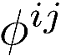
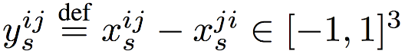
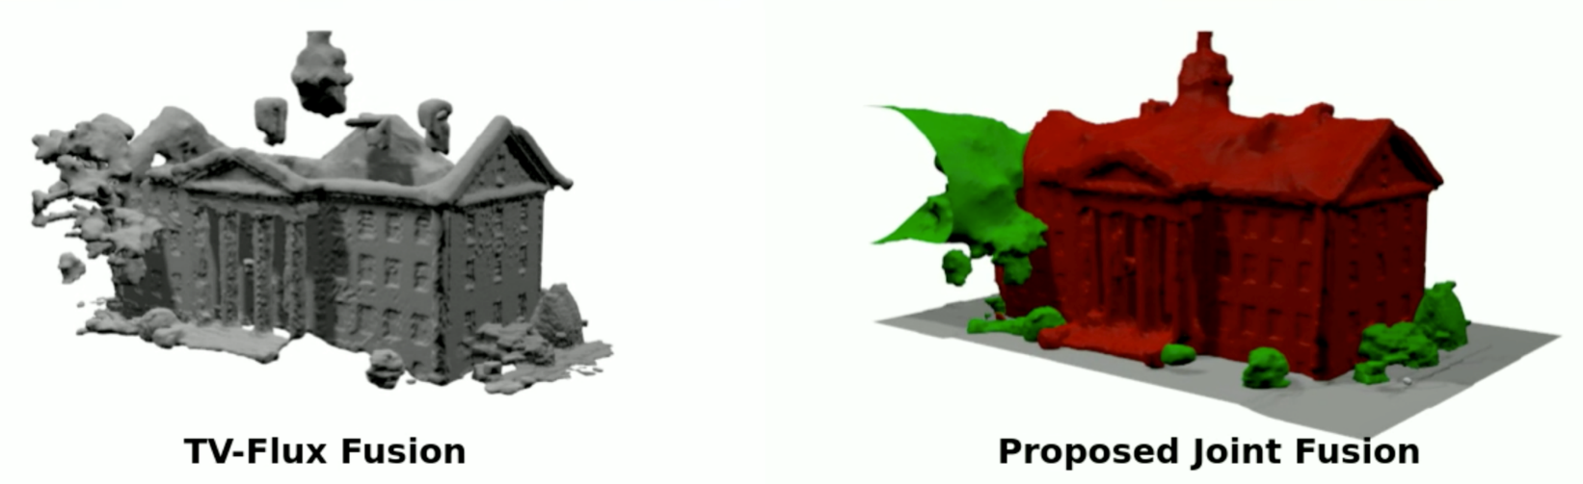
Method: Training the Priors
Class - Specific Geometric Priors
Goal: Model smoothness term
Recall:
is not dependent on position in space s
We are only interested in transitions from class i to j -> happen „rarely“
Smoothness depends on change from class i to j and normal
Transition of classes (Sky, Building, Ground) correlate to particular surface normals
Examples
Sky <-> Ground -> Normal points upwards / Sky <-> Fasade -> Normal points horizontly
Sky <-> Ground -> No normal pointing downwards
✔
Regularization
Data Term
Notes:
We leave the remarks and th monte carlo thing for the interesed?

Slide 15
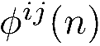
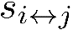
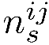
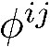
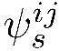
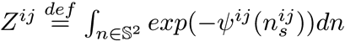
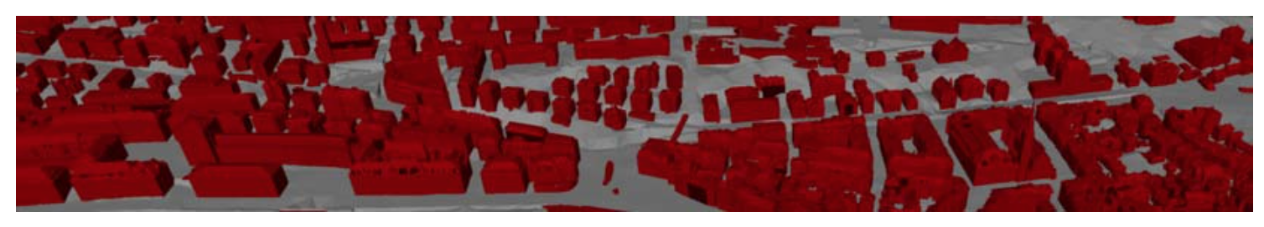
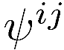
Method: Training the Priors
Class - Specific Geometric Priors
Goal: Model , interpreted as negative log-probabilities
- probability for transition i <-> j for given normal n
- transition event between label i and j at voxel s
- unit-length boundary normal at this voxel s
Instead of moedling direclty, we use
Modeled as a Gibbs probability measure
for a pos. 1-homog. Function and the respective partition function
Consequently
Train over data
But how choose/train convex positive 1-homog. Function ?
section of 3D cadastral city model

Slide 16
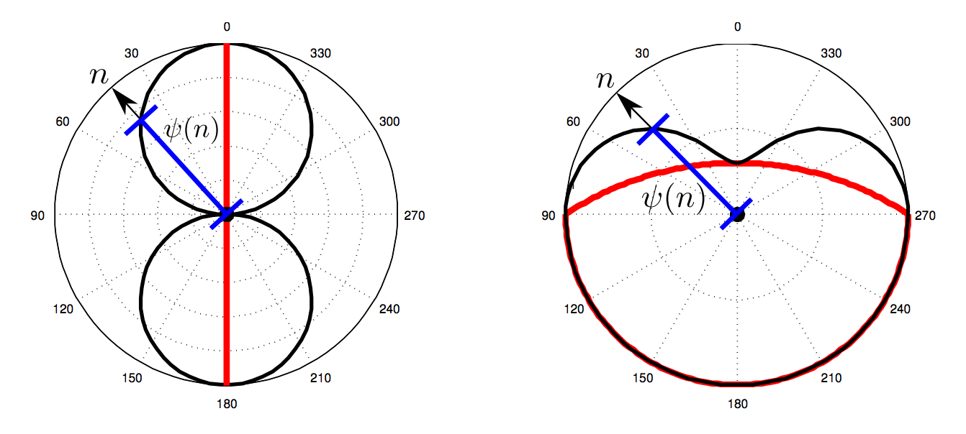
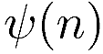
Method: Training the Priors
Class - Specific Geometric Priors
Goal: Choose good
What does stand for?
In general, isotropic regulizer: All surface directions are penelized the same -> sphere
More elaborate, anisotropic regulizer: distinguishing between Normals -> e.g. elipse
Papers approach: Wulf Space -> Convex shape trained on data for every class change i <-> j
Energy function gets penalized for normal direction n with value : length of blue line
Red Line <-> Wulf Space
1. Line Shape
<-> favors surface normals orthogonal to a given direction
<-> fasades
2. Half-sphere plus spherical cap
<-> favors surface normals in alignment with specific direction
<-> ground

Slide 17
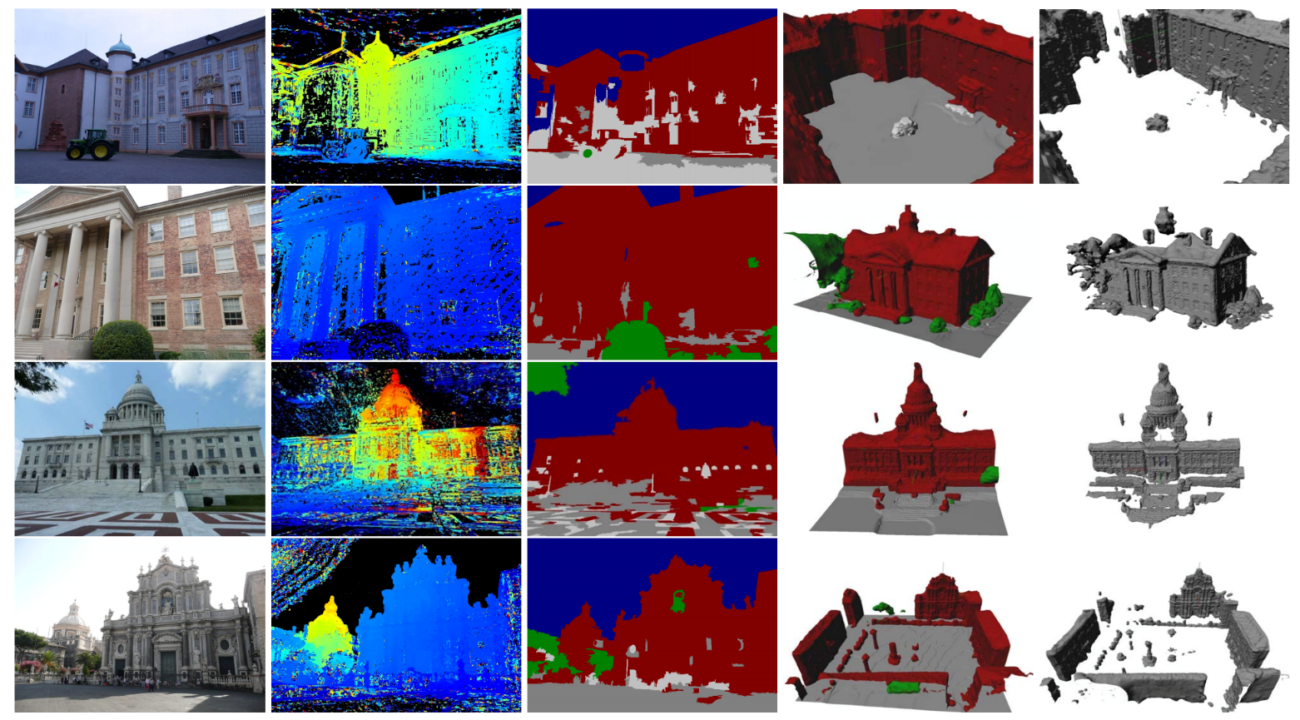
Experiments & Conclusion
The approach leads to more accurate geometry and image segmentation is improved (Col. 4)
Image & Depth map
Raw Image Labeling confuses:
Ground, building and clutter
TV-Flux (standard): Misses ground fully,
Particially facadas and roof structure
Source: Hane_Joint_3D_Scene_2013_CVPR_paper
Notes:
Foto ist auf der rechten Seite, damit wir zeigen können wo das Problem bei Tensorflow wo was wir jetzt durch Keras behoben haben.

